Slide 1
Customers, Suppliers, and the Adversaries that come with them
John Lambert, @JohnLaTwC
Microsoft Threat Intelligence Center

Slide 2
Activity Groups
H
hydrogen
1
He
helium
2
Li
lithium
3
Be
beryllium
4
B
boron
5
C
carbon
6
N
nitrogen
7
O
oxygen
8
F
fluorine
9
Ne
neon
10
Over 110 groups known to us
Over 70 full-fledged Activity Groups
Na
sodium
11
Mg
magnesium
12
Al
aluminium
13
Si
silicon
14
P
phosphorous
15
S
sulphur
16
Cl
chlorine
17
Ar
argon
18
K
potassium
19
Ca
calcium
20
Sc
scandium
21
Ti
titanium
22
V
vanadium
23
Cr
chromium
24
Mn
manganese
25
Fe
iron
26
Co
cobalt
27
Ni
nickel
28
Cu
copper
29
Zn
zinc
30
Ga
galium
31
Ge
geramanium
32
As
arsenic
33
Se
selenium
34
Br
bromine
35
Kr
krypton
36
Rb
rubidium
37
Sr
strontium
38
Y
yttrium
39
Zr
zirconium
40
Nb
niobium
41
Mo
molybdenum
42
Tc
technetium
43
Ru
ruthenium
44
Rh
rhodium
45
Pd
palladium
46
Ag
silver
47
Cd
cadminium
48
In
indium
49
Sn
tin
50
Sb
antimoney
51
Te
tellurium
52
I
iodine
53
Xe
xenon
54
Cs
caesium
55
Ba
barium
56
Hf
hafnium
72
Ta
tantalum
73
W
tungsten
74
Re
rhenium
74
Os
osminium
76
Ir
iridium
77
Pt
platinum
78
Au
gold
79
Hg
mercury
80
Tl
thallium
81
Pb
lead
82
Bi
bismuth
83
Po
polonium
84
At
astatine
85
Rn
radon
86
Rf
rutherfordium
112
104
Db
dubnium
105
Sg
seaborgium
106
Bh
bohrium
107
Hs
hassium
108
Mt
meitnerium
109
Ds
darmstadtium
110
Rg
goentgenium
111
Cn
copernicium
Nh
nihonium
113
Fl
flerovium
114
Mc
moscovium
115
Lv
livermorium
116
Ts
tennessine
117
Og
oganesson
Fr
francium
118
Fr
francium
87
Ra
radium
Ra
radium
88
La
lanthanum
57
Ce
cerium
58
Pr
praseodymium
59
Nd
neodymium
60
Pm
promethium
61
Sm
samarium
62
Eu
europium
63
Gd
gadolinium
64
Tb
terbium
65
Dy
dysprosium
66
Ho
holmium
67
Er
erbium
68
Tm
thulium
69
Yb
ytterbium
70
Lu
lutetium
71
Ac
actinium
89
Th
thorium
90
Pa
protactinium
91
U
uranium
92
Np
neptunium
93
Pu
plutonium
94
Am
americium
95
Cm
curium
96
Bk
berkelium
97
Cf
californium
98
Es
einsteinium
99
Fm
fermium
100
Md
mendelevium
101
No
nobelium
102
Lr
lawrencium
103

Slide 3
Tenants bring their adversaries with them

Slide 4
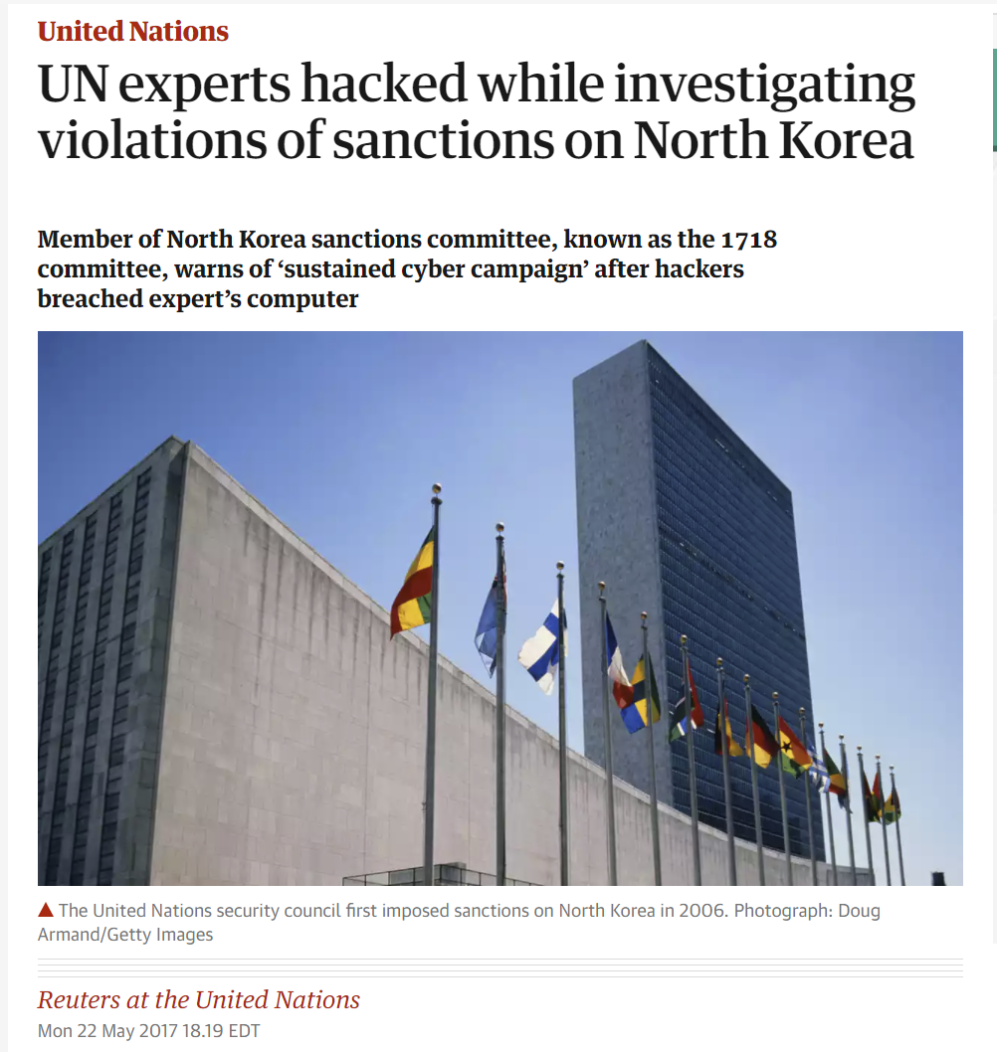
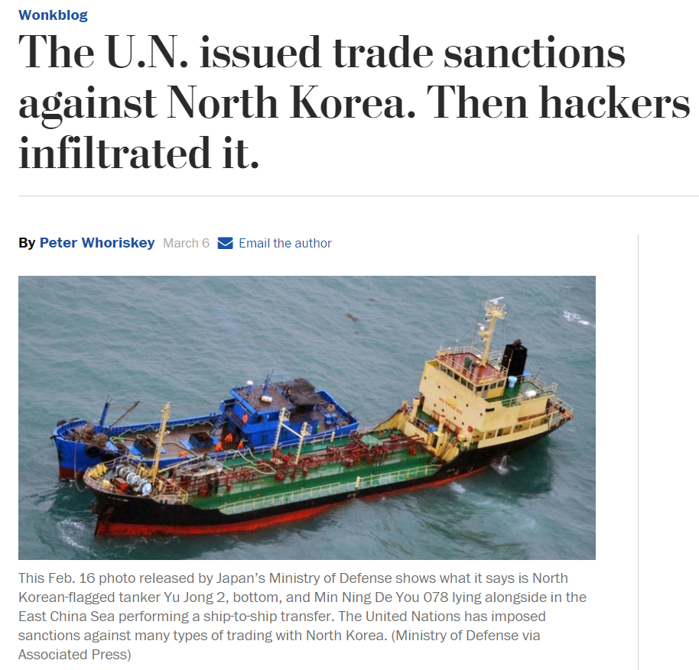
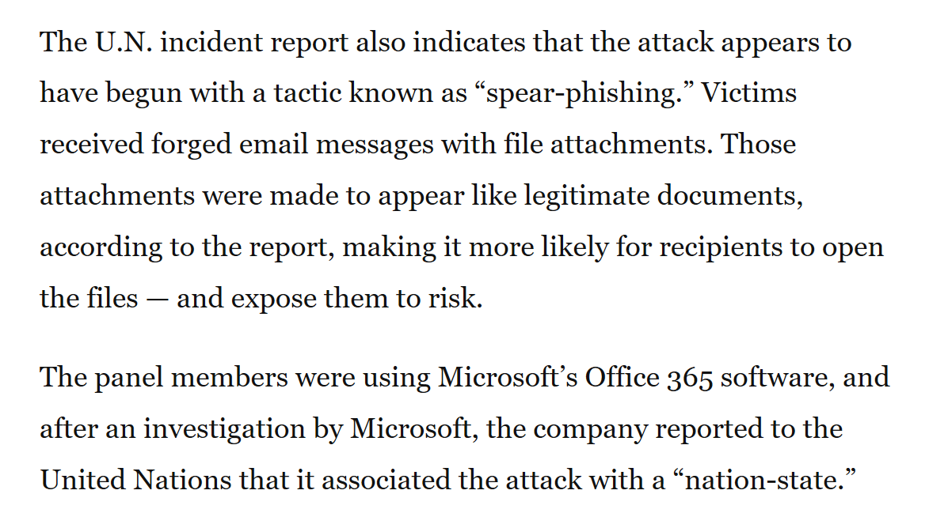
Credential Attacks - THALLIUM

Slide 5
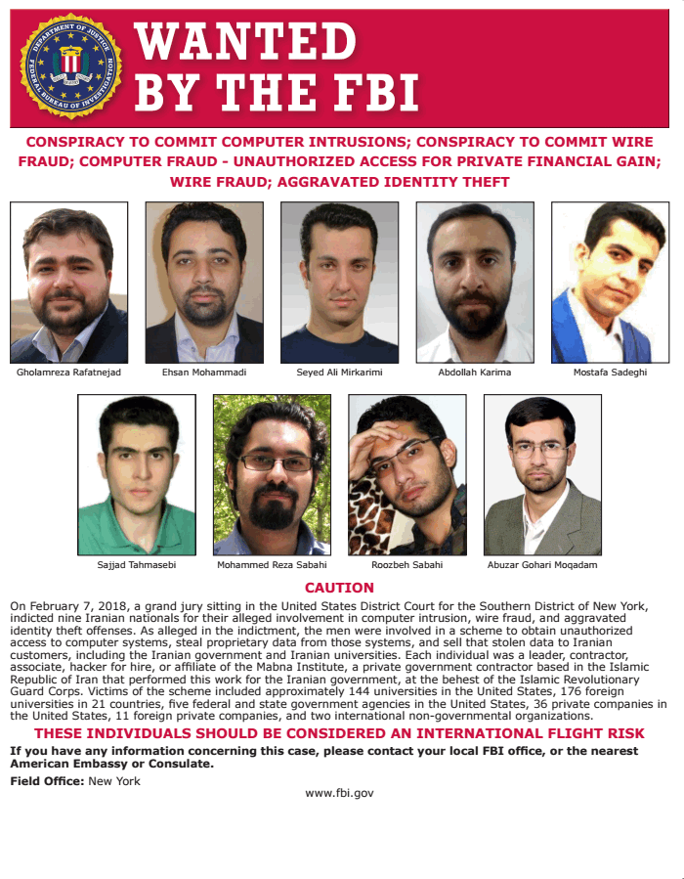

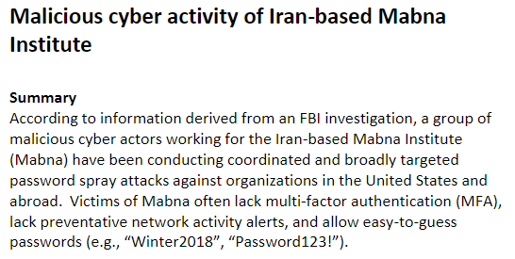
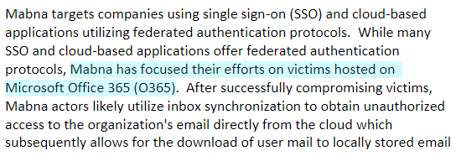
Mabna Institute
~300 Universities
Stole 30 TBs of IP
8,000/100,000 accounts
Focused on O365
Setup Email Forwarding

Slide 6
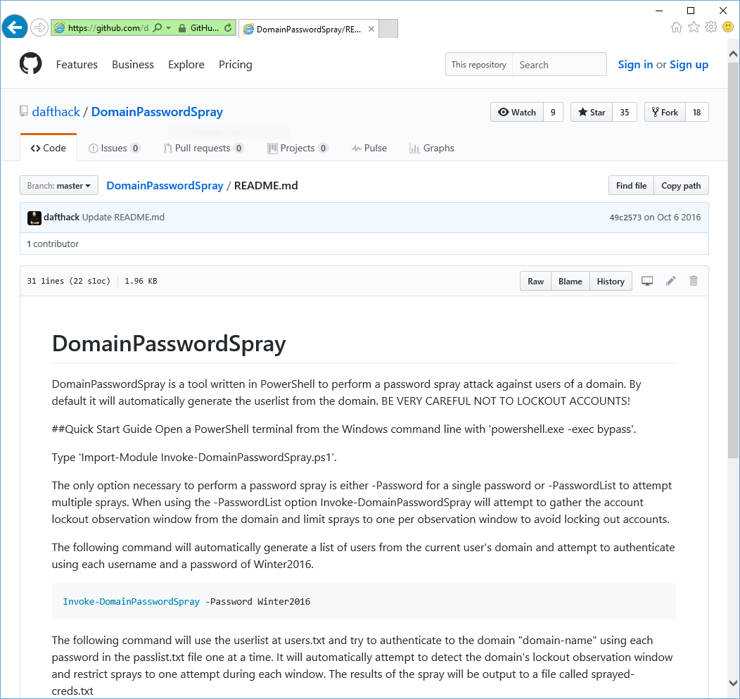
Password Spray
Requires only minimal knowledge of PowerShell and your target
Automatically detects:
LockoutThreshold policy
Fine-grained Password Policy
Minimum Password Length
Finds the lowest account lockout threshold in the domain to avoid locking out any accounts
Slowly tests for weak passwords

Slide 7
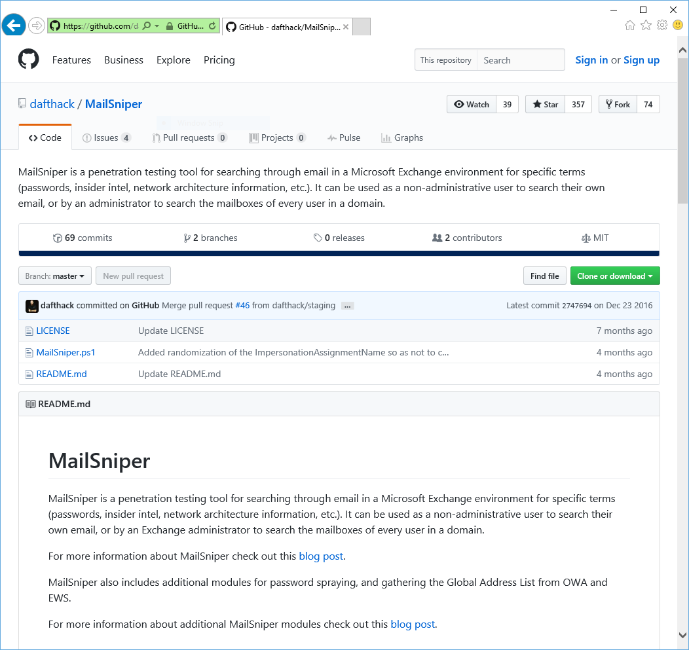

Mail Sniper
PowerShell script pen test tool used against Exchange Web Services (EWS)
Works against EWS endpoint
If not known, Autodiscover process helps to locate the EWS endpoint URL
Integrates Password Spray module

Slide 8
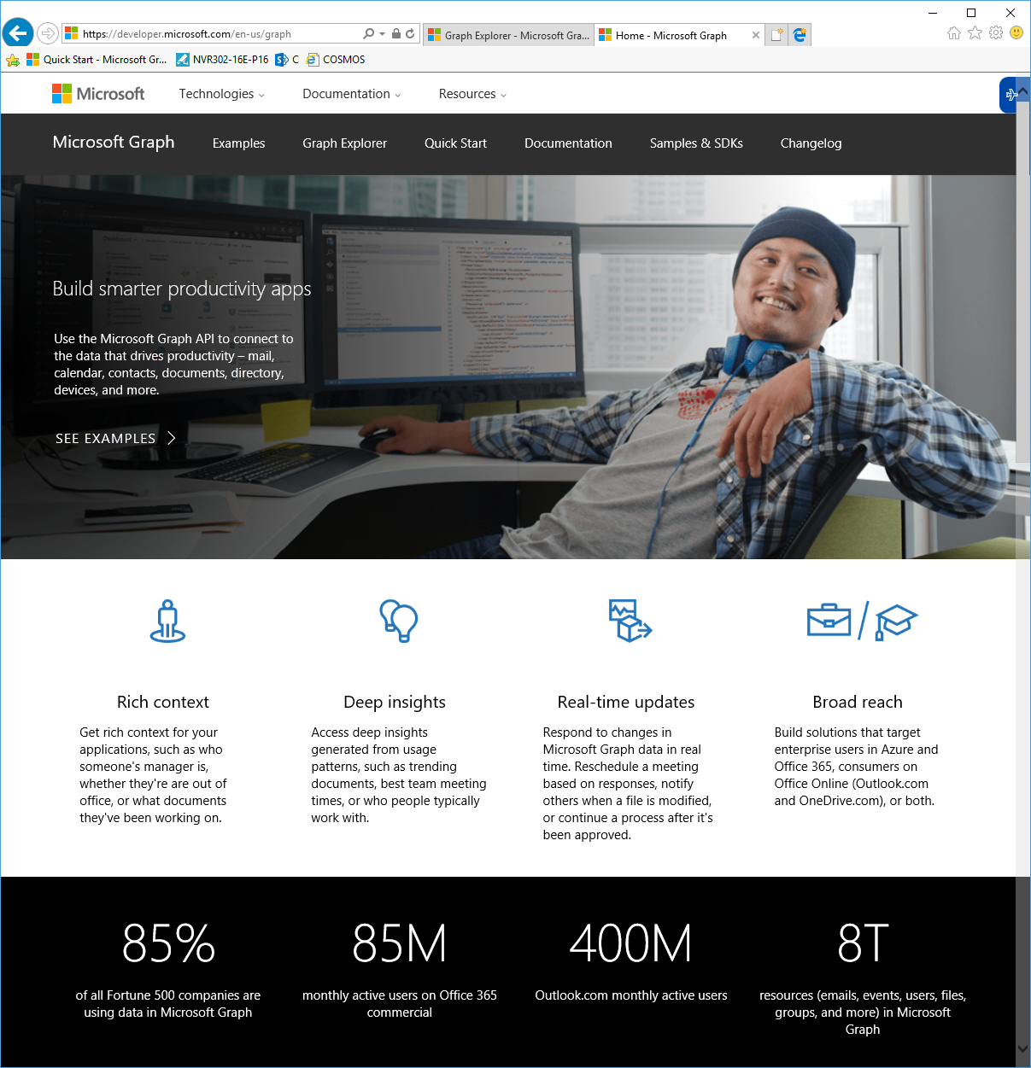
Graph API
Notes:
This is how they do recon in the cloud
As opposed to TallMan, where they did recon on the command line. \

Slide 9
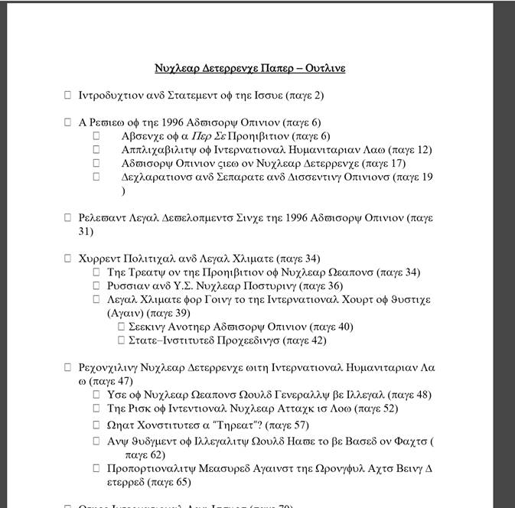
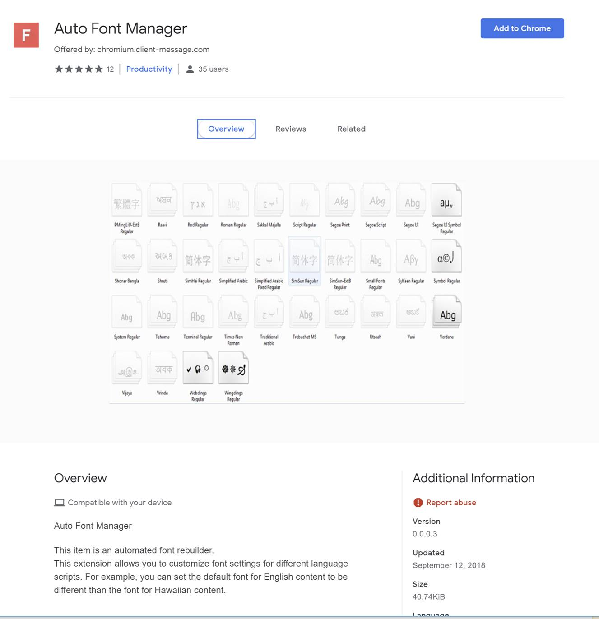
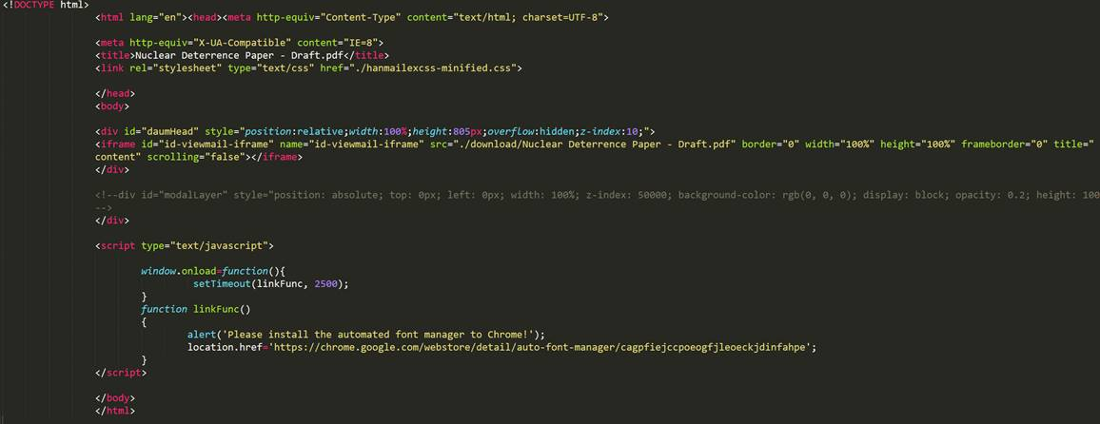
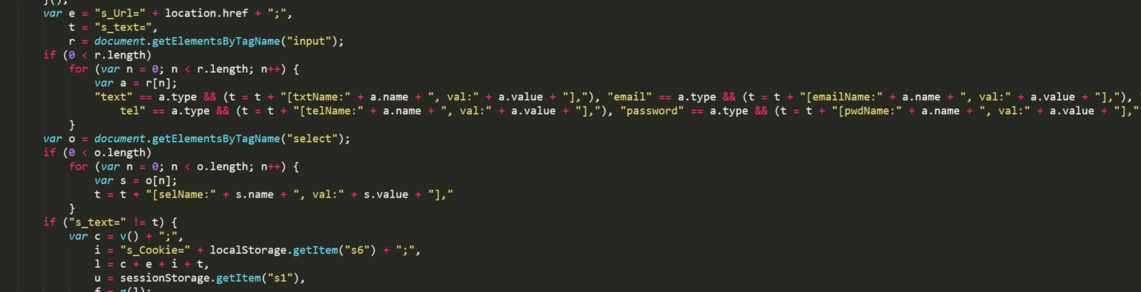
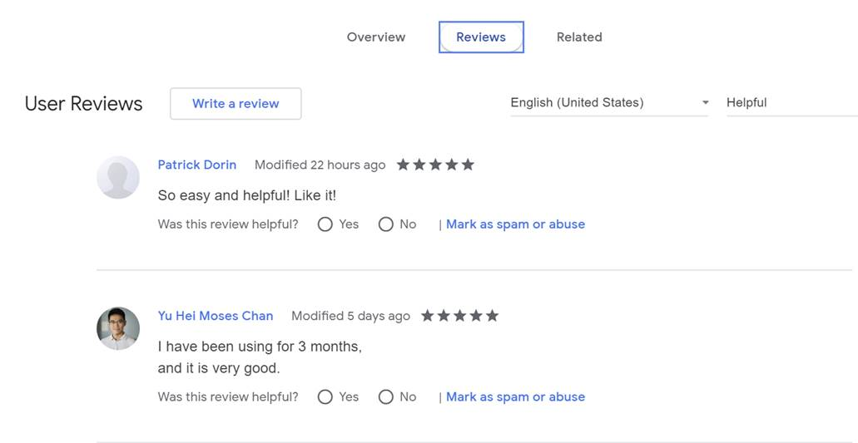
THALLIUM Attack
'google.c'
'outlook.c’
‘<victim specific domain>'
'yahoo.c'
'aol.com'
'microsoftonline.com'

Slide 10
A choice of Technology is a choice of Attack Surface

Slide 11
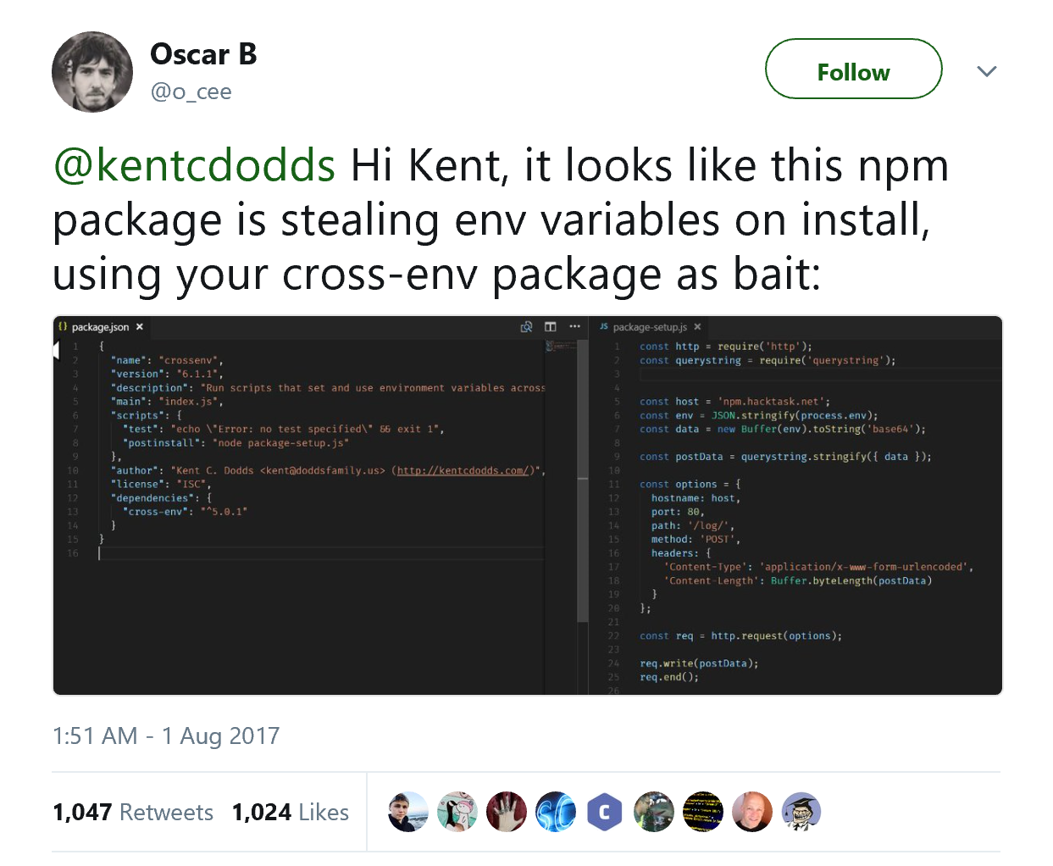
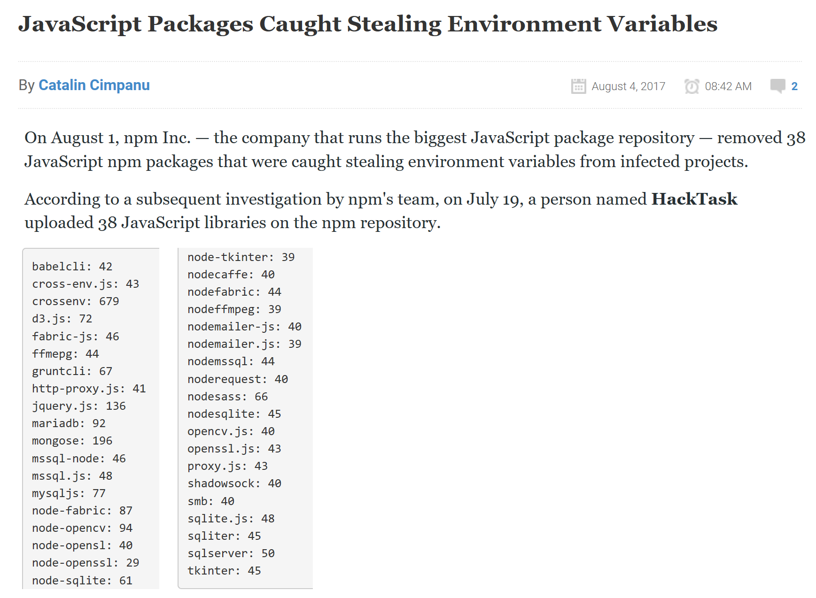
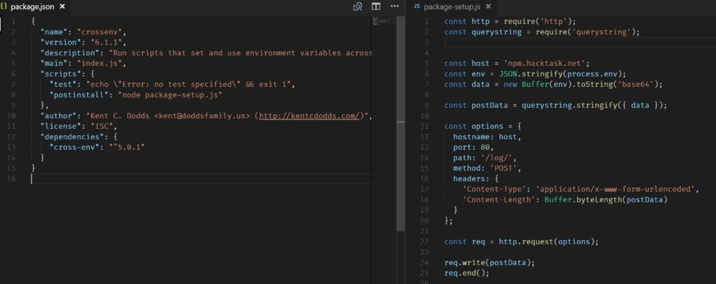
Malicious JavaScript Packages on npm

Slide 12
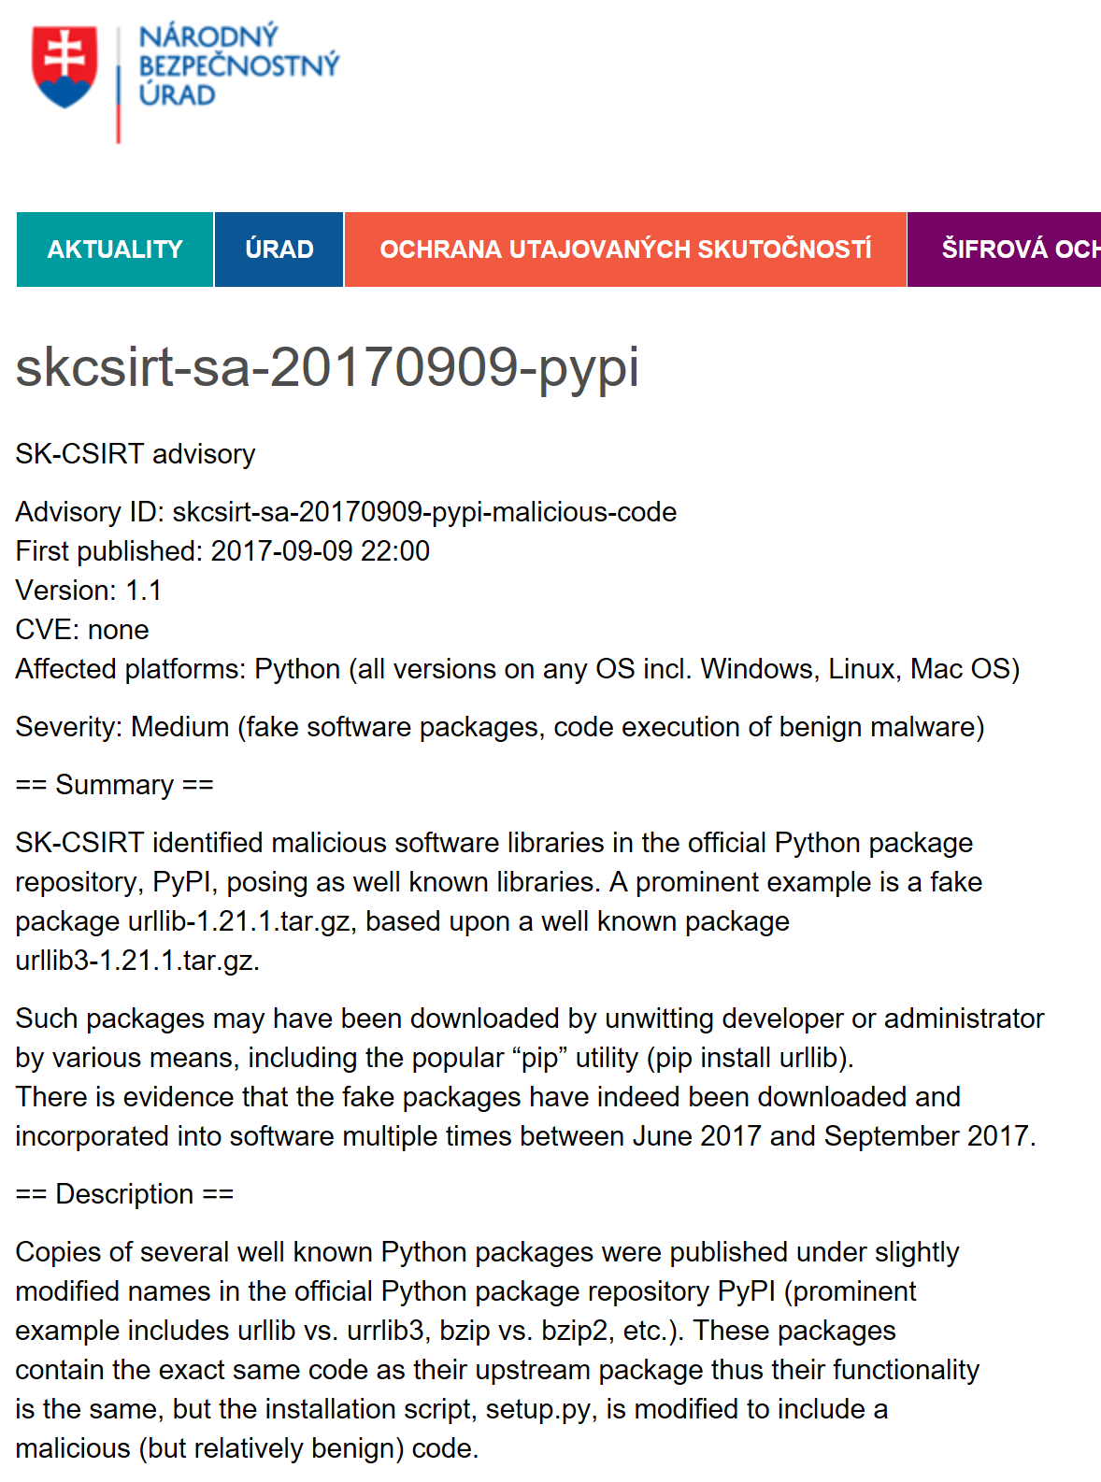
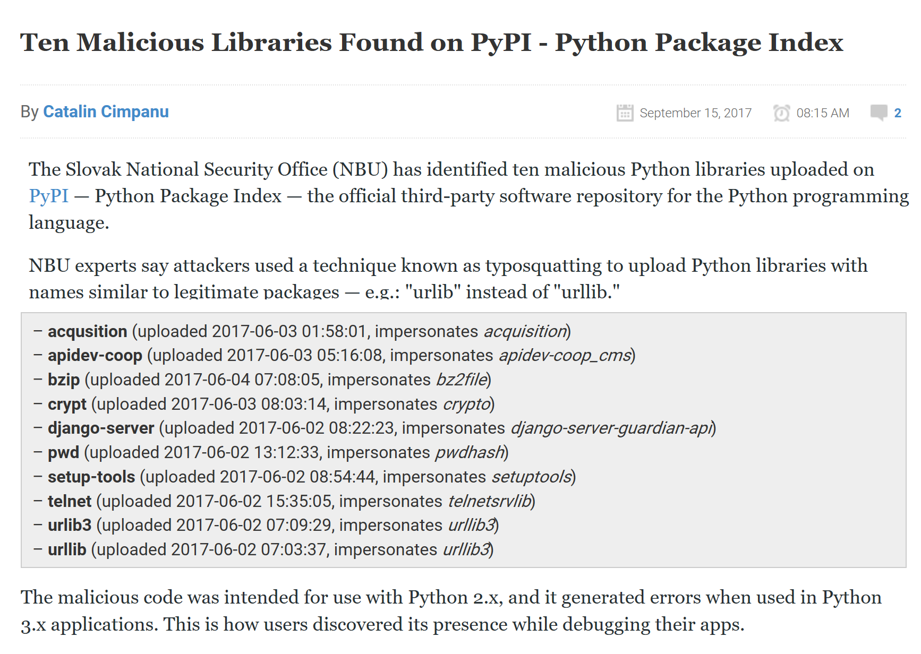
Malicious Python Packages on PyPI

Slide 13
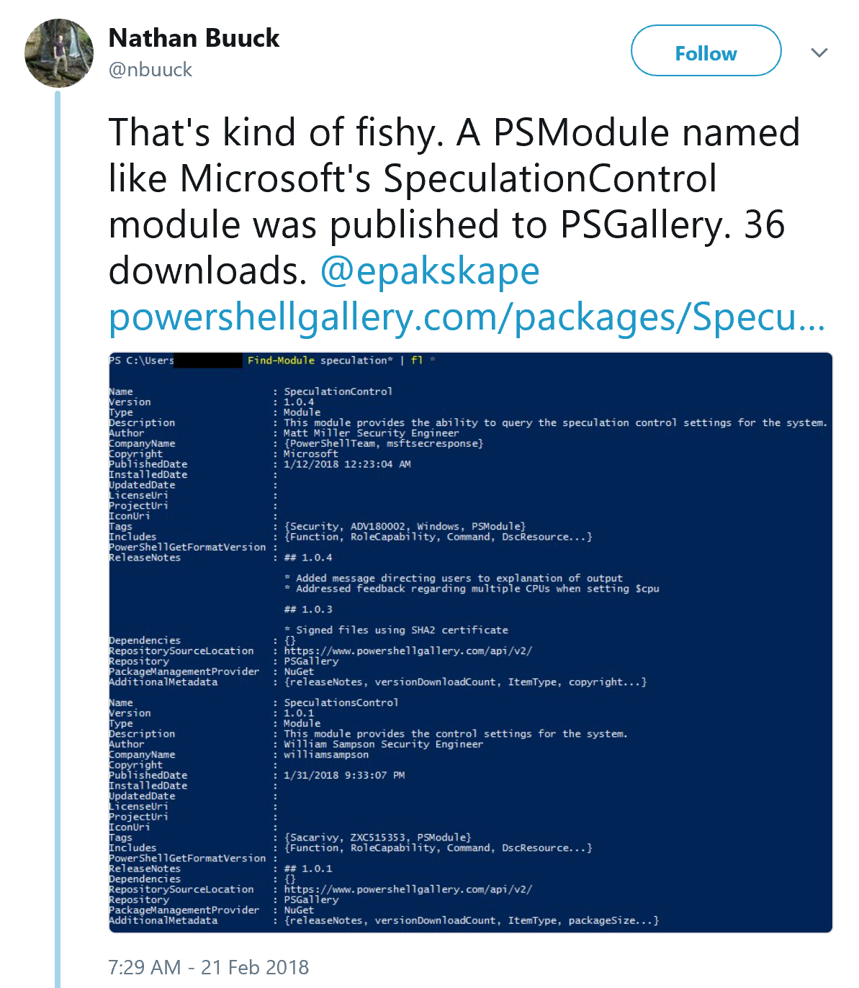
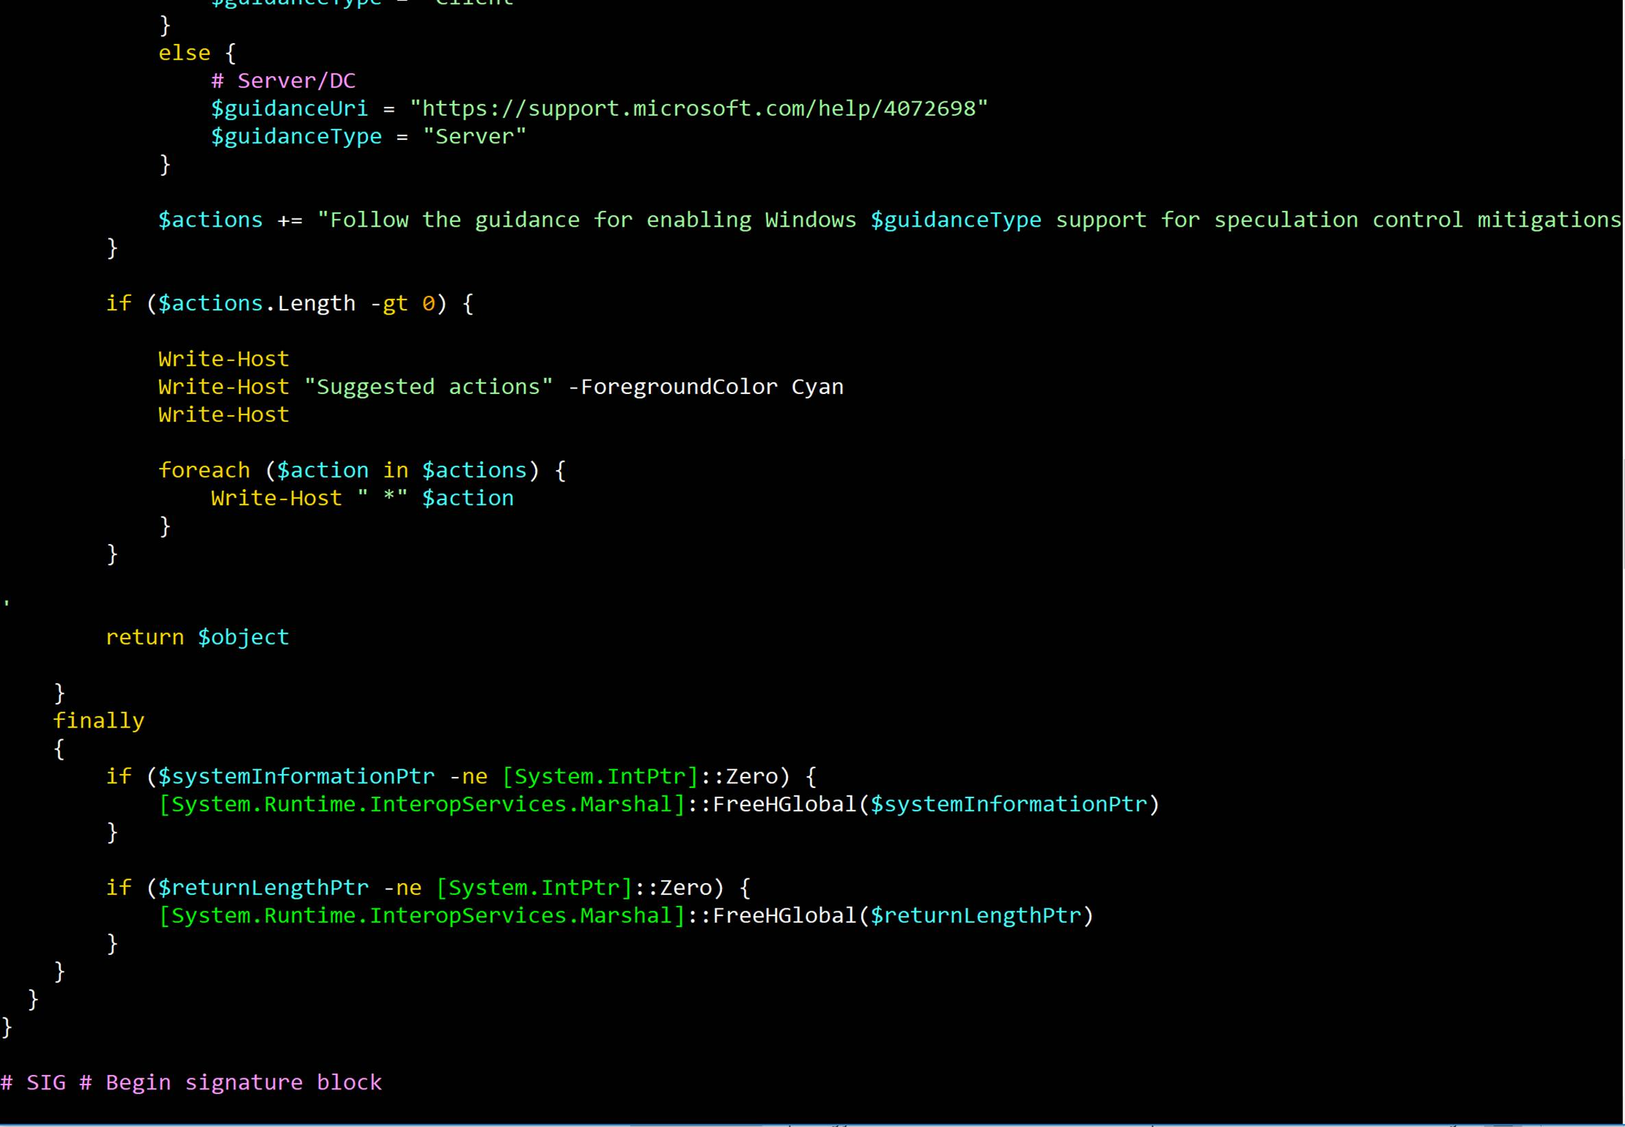
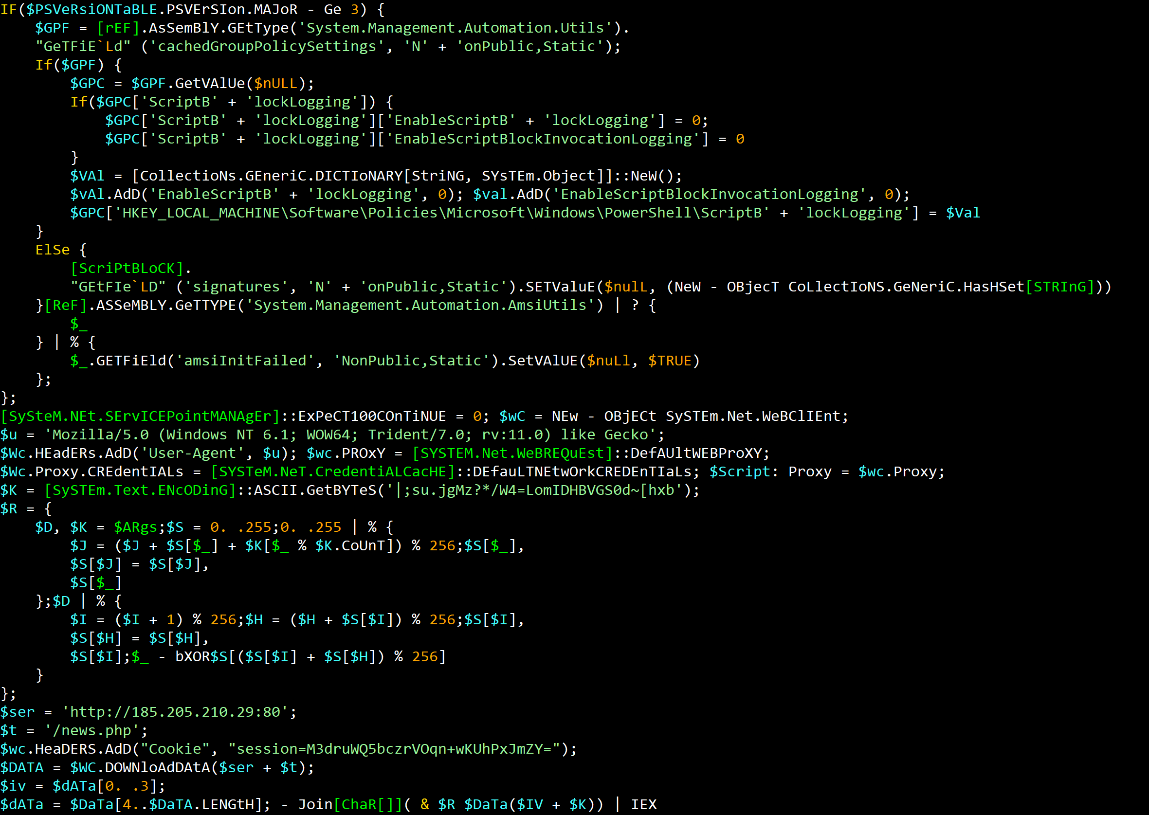
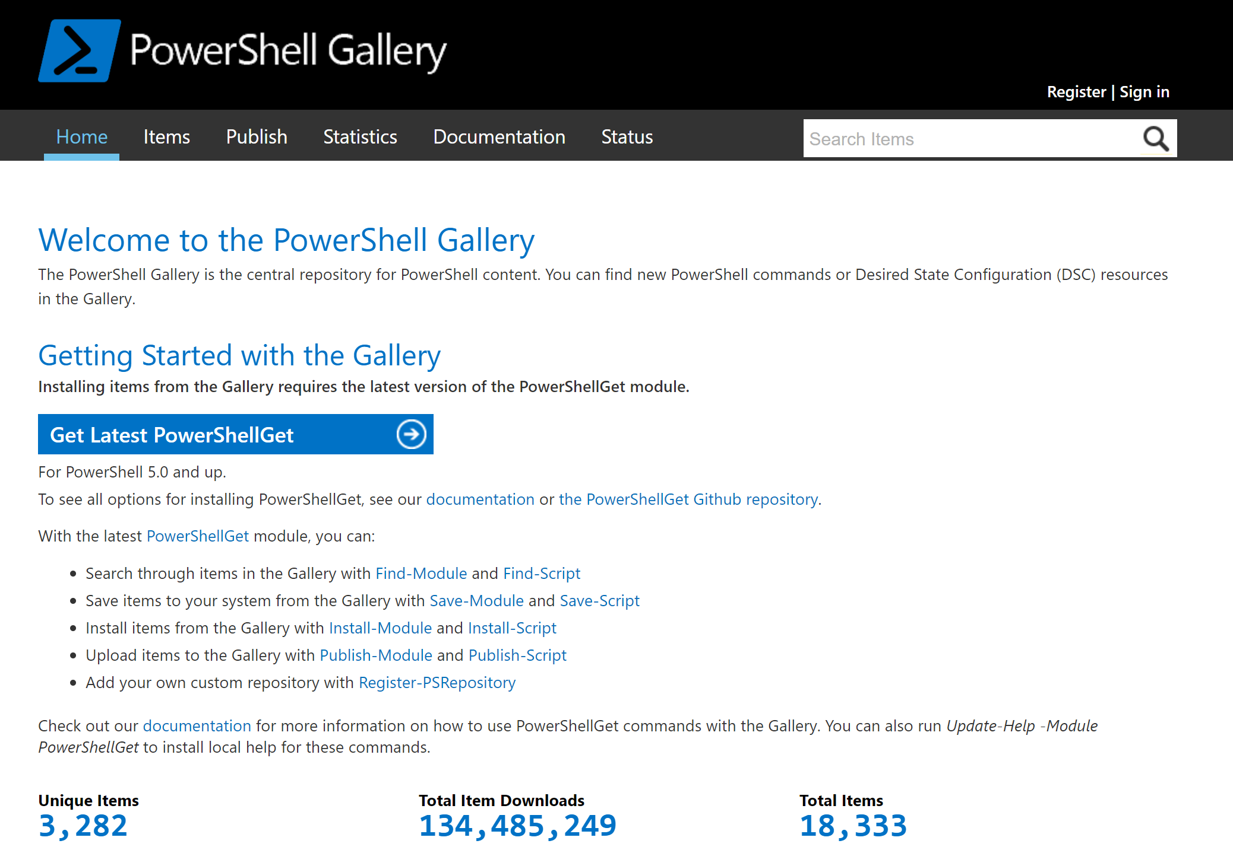
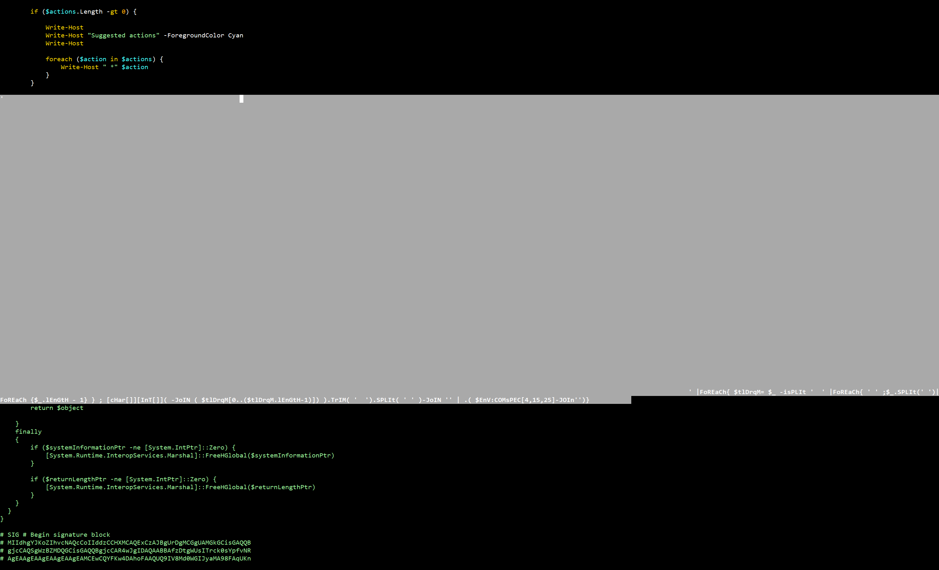
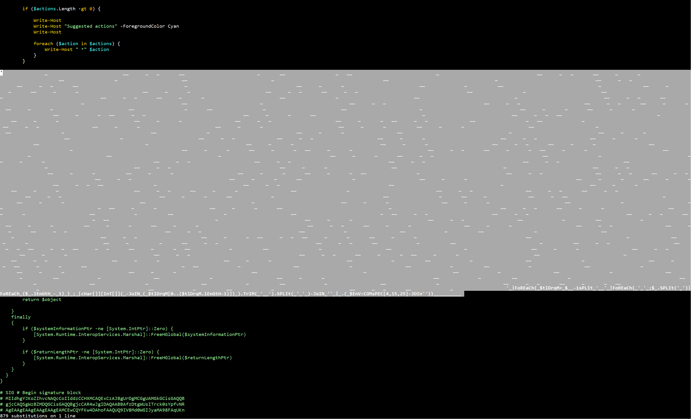
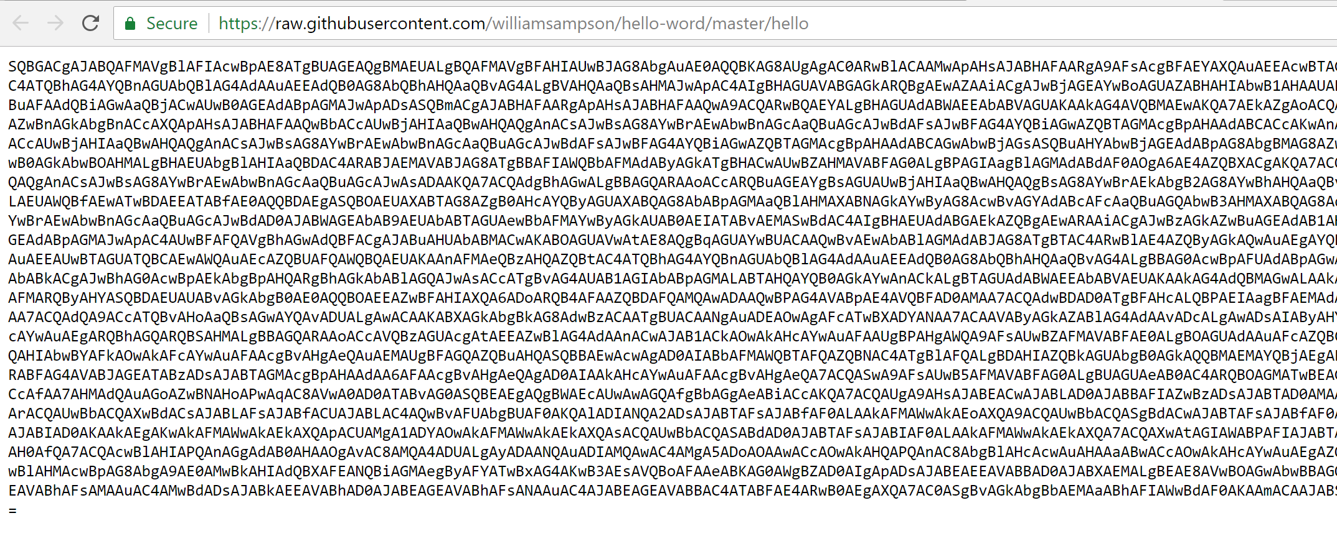
PowerShell Gallery
← Extra S
Notes:
https://twitter.com/nbuuck/status/966334165493874688

Slide 14
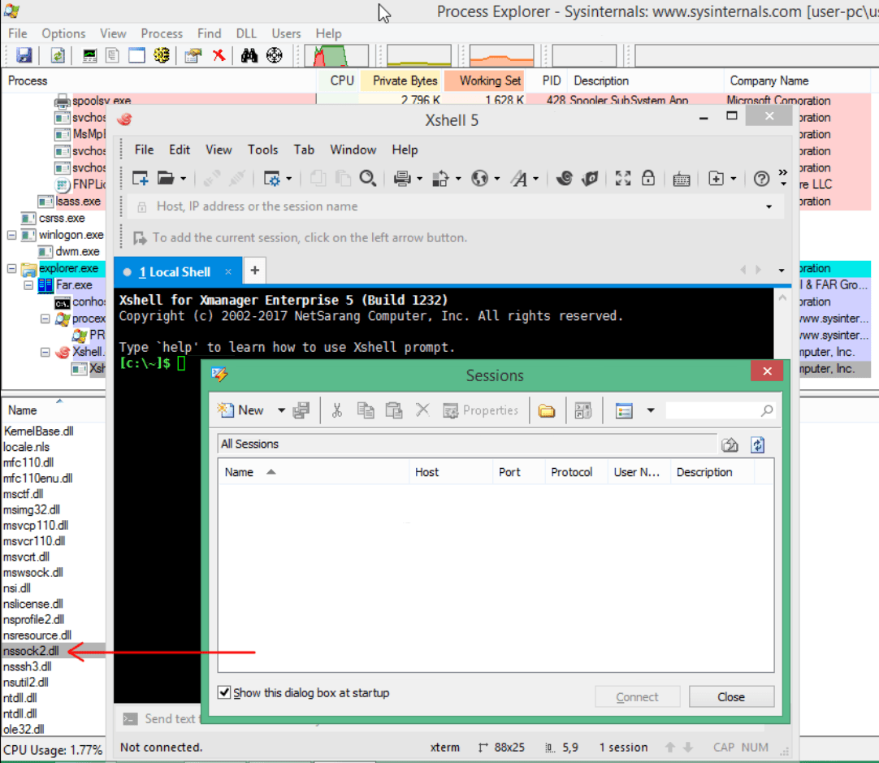
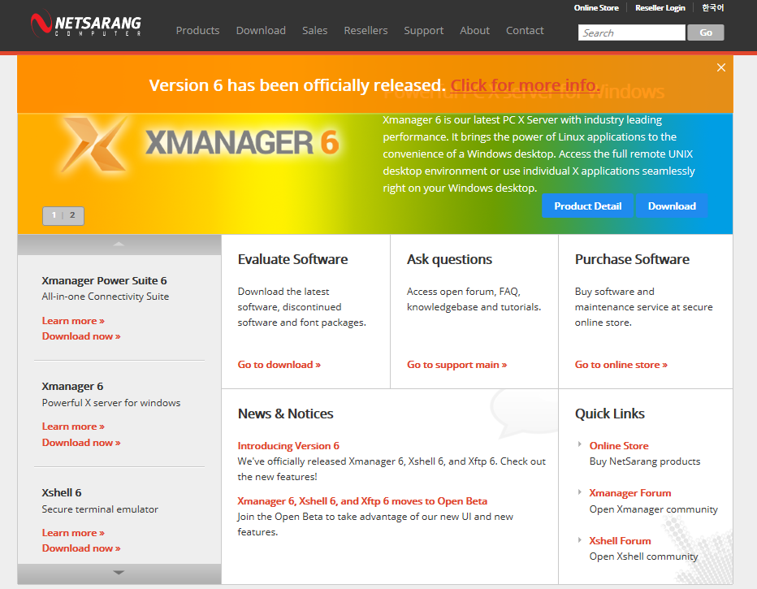
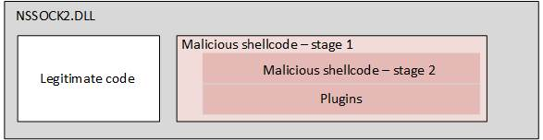
Supply Chain Attacks - Barium
NetSarang
Leverage software update mechanisms
Dangerous because the mechanism is central to trust in software
Spreads quickly to all customers receiving updates
Source: Kaspersky

Slide 15
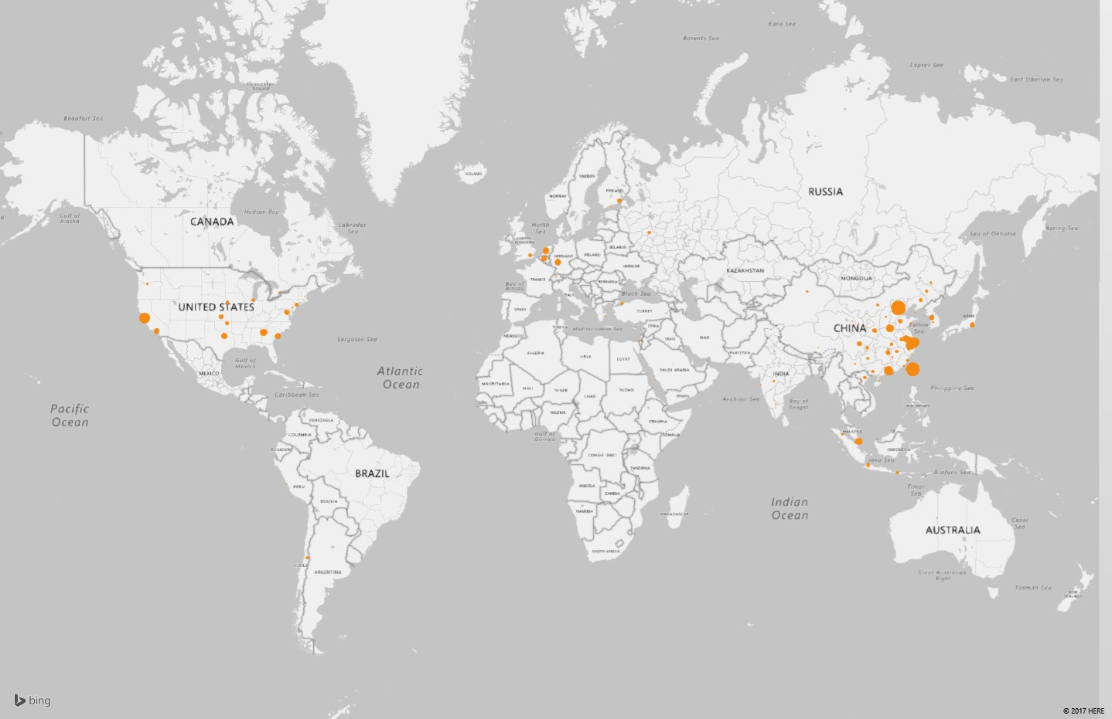
Effect of the NetSarang Attack
Hits: 464,414
Victims: 4,950
Countries: 52
Identified company victims: 46

Slide 16
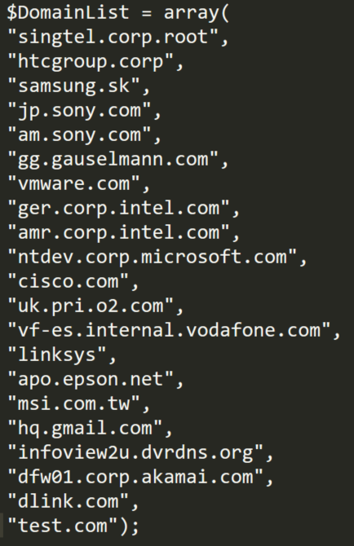
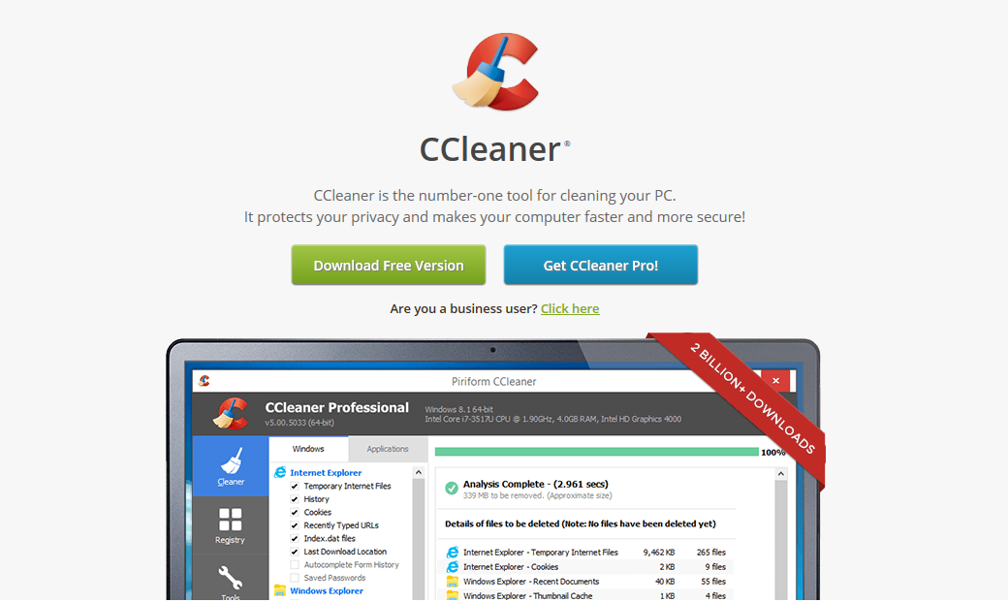
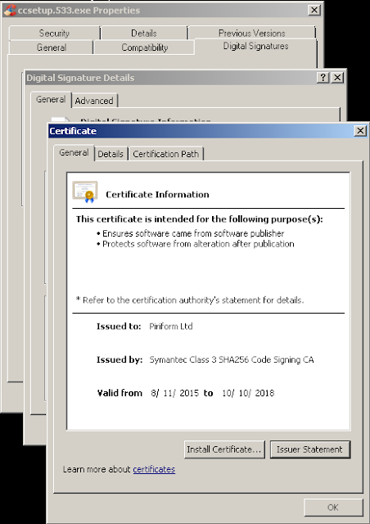
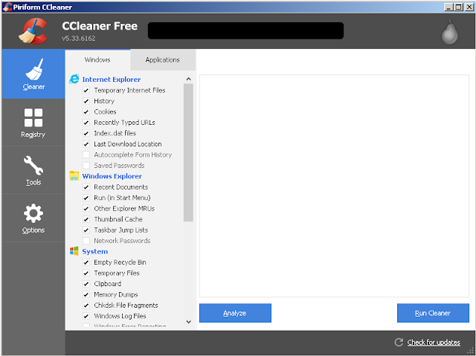
Ccleaner Attack
Source: Talos
Notes:
https://blog.avast.com/update-ccleaner-attackers-entered-via-teamviewer

Slide 17
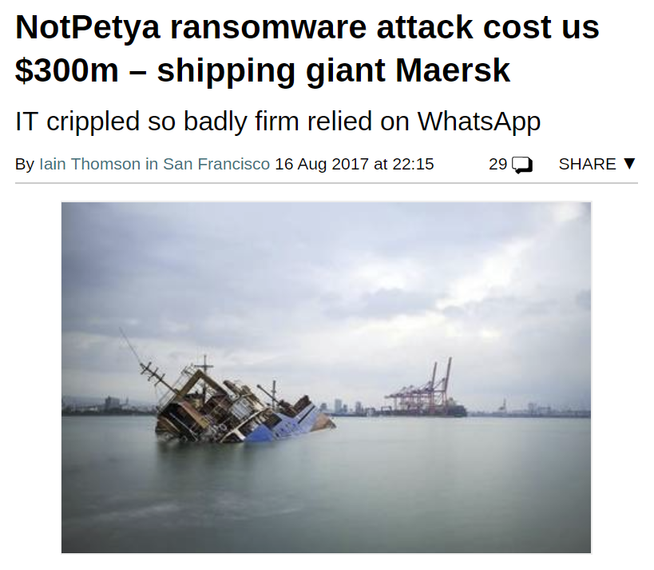
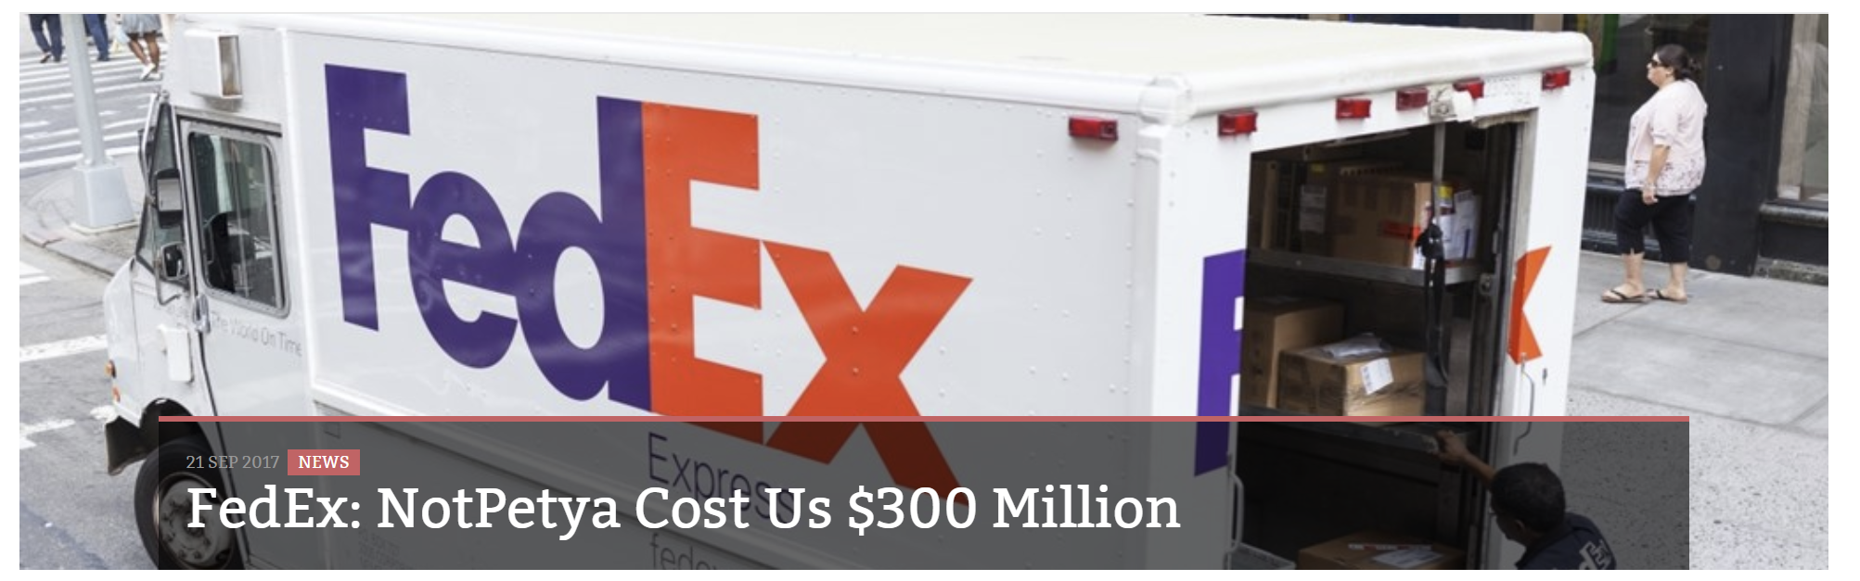
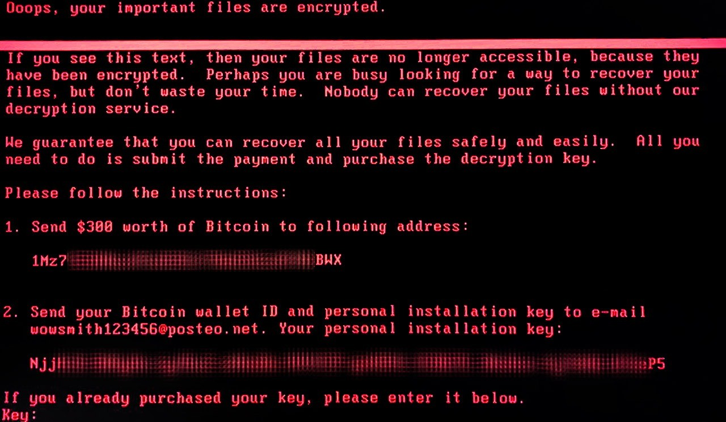
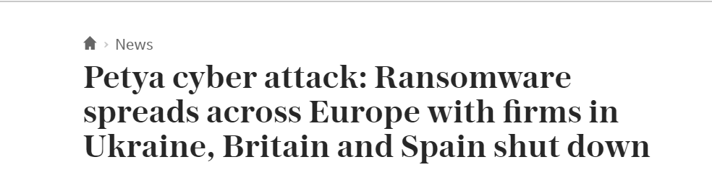
NotPetya – Designed to Destroy

Slide 18
Now-Near-Deep Systems

Slide 19
Moving from using security to protect data to data providing security
Customers are at the center | Product + IP = Customer → Product + Customers = IP
Multi-dimensional | Uses a combination of zoom levels, temporal views, and levels of resolution simultaneously
Signal Seeking | Consumes and creates context to tune thresholds, confidence levels, and inform prioritization
Supervised Learning | Human-In-The-Loop → Human-Over-The-Loop
Especially empowered by SaaS and Cloud

Slide 20
Now-Near-Deep Systems
Now – answers in milliseconds
High transaction volume
Low dimension data
Verdict oriented
Near – milliseconds to seconds
Moderate transaction volume
Medium dimension data
Signal oriented
Deep – minutes to hours
Large data volumes
High dimension data
Model oriented

Slide 21



Telemetry Centric Controls
Bucketing Functions
Extract key dimensions
Dependent on richness of the data
Lower dimensional data
Labeling
Analyze and decide verdict or labels
E.g. mapping, analysis, classifier, …
Promotion Signals
Signal of insight of “new issue”
Selector for higher analysis
Key to scalable system
Signals
Labels
Supervised Automatic Learning
Seek signals for self-correction
Resiliency and Robustness
HITL → Human Over The Loop
Higher dimensional data

Slide 22
A Look at Windows Error Reporting

Slide 23

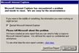



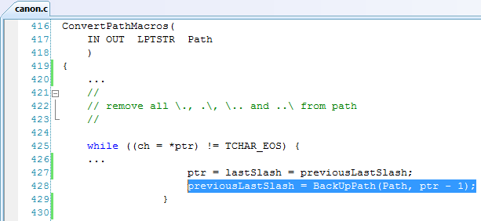

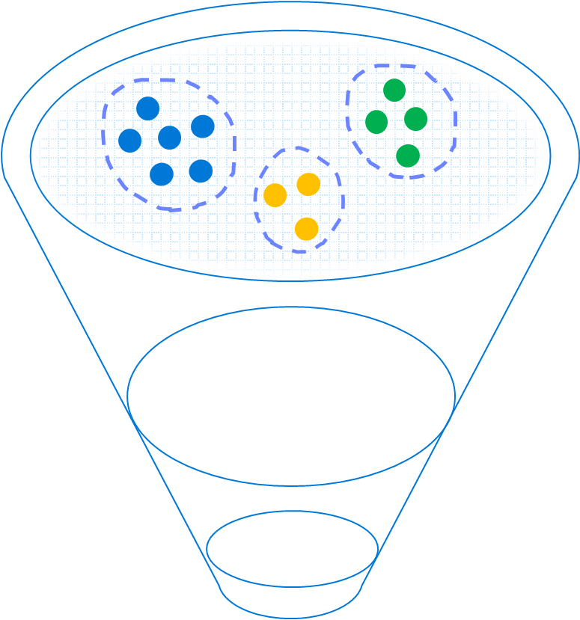
Windows Error Reporting: Bucketing Level One
Windows Error Reporting
Now
Scale: Billions of hits per month
Label: Solution exists to problem
No PII collected
GET http://watson.microsoft.com with the following URI:
/svchost_exe/5_1_2600_3264/470c3339/NETAPI32_dll/5_1_2600_3264/470c3339/c0000005/00018ae1.htm
App Name
App Version
App Timestamp
Module Name
Module Version
Module Timestamp
Exception
Offset in Module of Fault

Slide 24
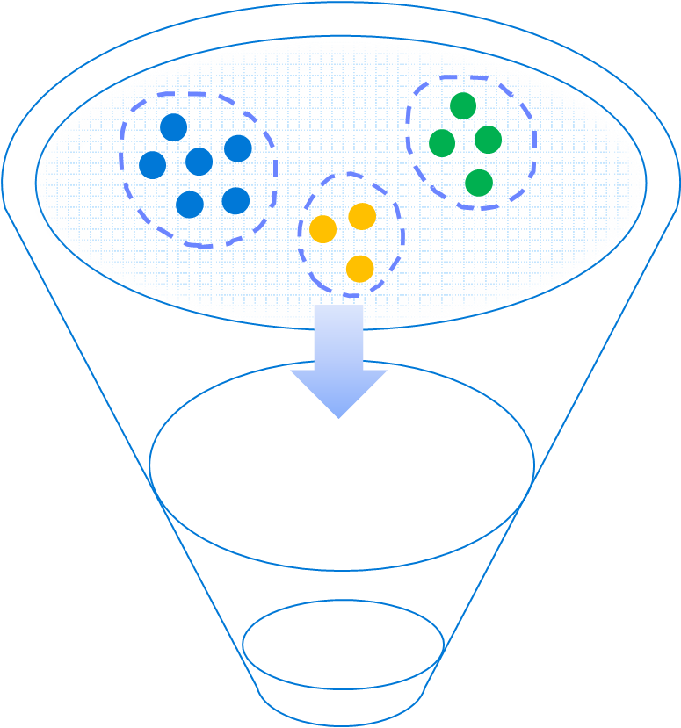
Windows Error Reporting: Labels
/BEX/dns_exe/5_2_3790_172/470c3339/dns_exe/5_2_3790_172/00012082/c0000409.htm
Some unknown stack buffer overrun triggering /GS code
/csrs_exe/0_0_0_0/ntdll_dll/5_1_2600_2180/0001888f.htm
Malware: CSRS.EXE with no file-version masquerading as Windows binary
/svchost_exe/5_1_2600_3264/NETAPI32_dll/5_1_2600_3264/00018ae1.htm
MS08-067 Exploit
/BEX/Acrobat_exe/7_0_8_218/446abede/unknown/0_0_0_0/0c0c0c0c/c0000005/8.htm
Some Acrobat reader exploit against unpatched version
/BEX/AcroRd32_exe/<full patch>/446abede/unknown/0_0_0_0/0c0c0c0c/c0000005/8.htm
0-day

Slide 25
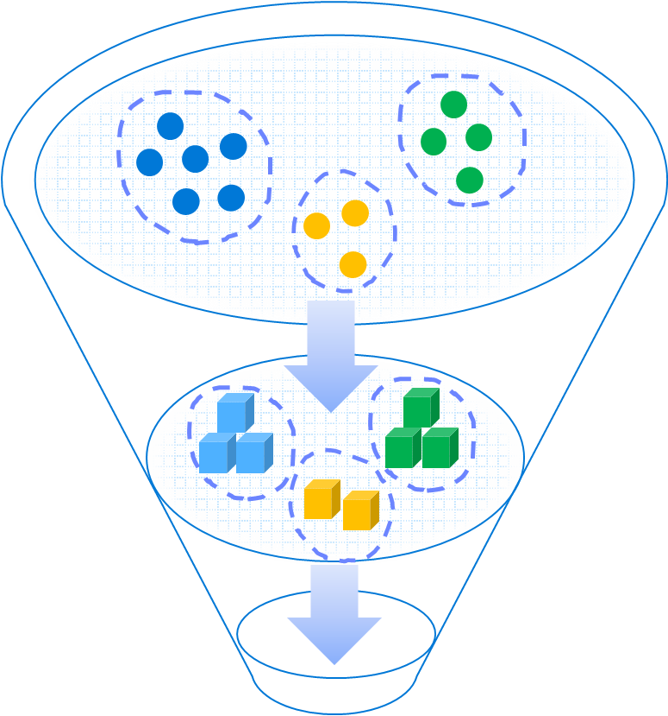
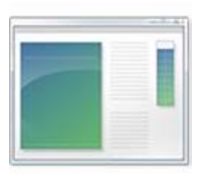
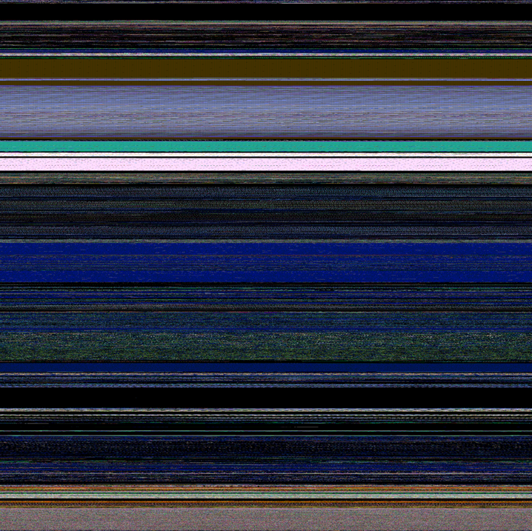
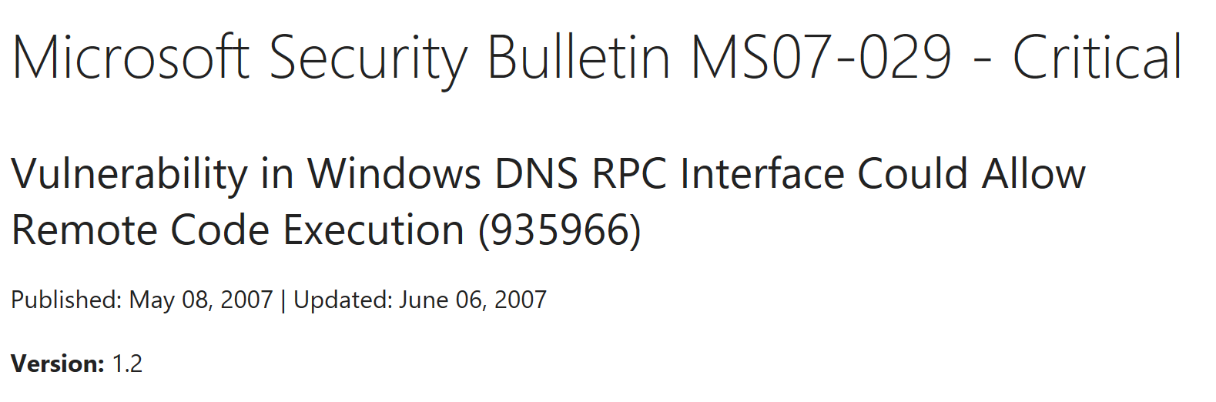
Windows Error Reporting: Bucketing Level 2
!analyze -v says:
Debug session time: Thu Mar 8 2007
FOLLOWUP_IP:
dns!Lookup_ZoneTreeNodeFromDottedName+5d
0103d68b c9 leave
IMAGE_NAME: dns.exe
PRIMARY_PROBLEM_CLASS: STACK_OVERRUN
FAILURE_BUCKET_ID:
APPLICATION_FAULT_STACK_OVERRUN_ dns!Lookup_ZoneTreeNodeFromDottedName+5d
Loaded Modules
Crashing address
Call stack
PEB/TEB
Stack and Heap Memory
Command Line
Threads

Slide 26
Windows Error Reporting: Labeling Level 2
JavaScript was executing eval()
Word opening a file
jscript!JsEval+0x110
jscript!NatFncObj::Call+0x41
jscript!NameTbl::InvokeInternal+0xe0
jscript!VAR::InvokeByDispID+0xd4
jscript!CScriptRuntime::Run+0x16c9
jscript!ScrFncObj::Call+0x8d
jscript!CSession::Execute+0xa1
jscript!COleScript::ExecutePendingScripts+0x147
jscript!COleScript::ParseScriptText+0x2b
jscript!COleScript::ParseScriptTextCore+0x243
mshtml!CScriptCollection::ParseScriptText+0x240
mshtml!CScriptElement::Execute+0xc0
mshtml!CHtmParse::Execute+0x43
mshtml!CHtmPost::Broadcast+0x11
mshtml!CHtmPost::Exec+0x40d
mshtml!CHtmPost::Run+0x13
mshtml!PostManExecute+0xdc
mshtml!PostManResume+0x9e
mshtml!CHtmPost::OnDwnChanCallback+0x10
mshtml!GlobalWndProc+0x181
user32!DispatchMessageW+0xf
ieframe!CTabWindow::_TabWindowThreadProc+0x189
kernel32!BaseThreadInitThunk+0xe
ntdll!_RtlUserThreadStart+0x23
WWLIB!PmwdCreateCore+0x98c
WWLIB!PdodOpenFnmCore2+0x2183
WWLIB!PdodOpenFnmCore+0x4b
WWLIB!FFileOpenXstzCore+0x238
WWLIB!_FInitArgs+0x13a
WWLIB!FInitPart2+0xa1a
WWLIB!FInitWinInfo+0xbc
WWLIB!FMain+0x51e
WINWORD!WinMain+0x7b
WINWORD!__tmainCRTStartup+0x140
kernel32!BaseThreadInitThunk+0xe
ntdll!__RtlUserThreadStart+0x70
ntdll!_RtlUserThreadStart+0x1b
IE was running JavaScript

Slide 27

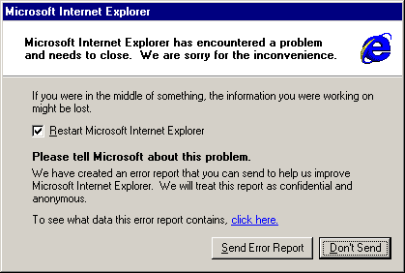

Data Execute Protection
Data Execute Protection violation
0:010> .exr -1
ExceptionAddress: 0a0a0a0a
ExceptionCode: c0000005
(SOFTWARE_NX_FAULT
Access violation)
ExceptionFlags: 00000001
NumberParameters: 1
Parameter[0]: 00000008
0:010> u 0a0a0a0a
0a0a0a0a 90 nop
0a0a0a0b 90 nop
0a0a0a0c 90 nop
0a0a0a0d 90 nop
0a0a0a0e 90 nop
0a0a0a0f 90 nop
0a0a0a10 90 nop
0a0a0a11 90 nop
0101 0101
0101 0101
0101 0101
0101 0101
0101 0101
0101 0101
0101 0101
0101 0101
0101 0101
0101 0101
0101 0101
0101 0101
0101 0101
0101 0101
0101 0101
Crash site not in loaded module
0101 0101
0101 0101
0101 0101
0101 0101
0101 0101
0101 0101
0101 0101
0101 0101
0101 0101
0101 0101
…filled with a NOP sled
Vuln code
Bucketed as: SOFTWARE_NX_FAULT_ FILL_PATTERN_90909090_ NXCODE_c0000005_<faulting symbol>

Slide 28

Detecting Heapspray through Entropy
Random normal crash
Heapsprayed crash

Slide 29
Windows Error Reporting: Bucketing Level One
Windows Error Reporting
Now
Scale: Billions of hits per month
Label: Solution exists to problem
No PII collected
GET http://watson.microsoft.com with the following URI:
/svchost_exe/5_1_2600_3264/470c3339/NETAPI32_dll/5_1_2600_3264/470c3339/c0000005/00018ae1.htm
App Name
App Version
App Timestamp
Module Name
Module Version
Module Timestamp
Exception
Offset in Module of Fault

Slide 30
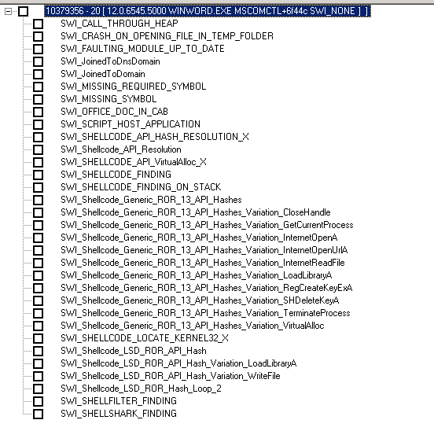
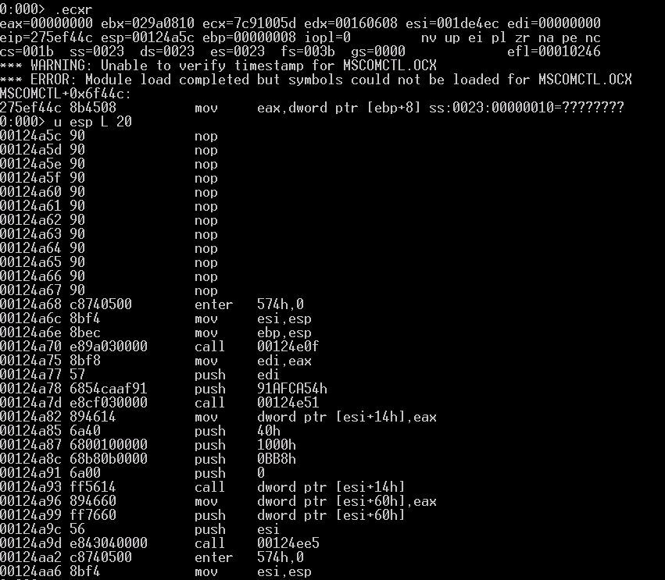
CVE-2012-0158 (MS12-027)
Windows Error Reporting

Slide 31
Malicious files
Stage one
File name File size Date Time Attrs
----------------------------- ---------- ---------- -------- -----
..\Temporary_Internet_Files\Content.Outlook\ADIFN8SX
\Technical_team_to_produce_requirements_document.docx
..\Temporary_Internet_Files\Content.MSO\2BE67846.php
\WINWORD.EXE.sig 3352 2011/10/28 15:49:58 ----
\WWLIB.DLL.sig 3352 2011/10/28 15:49:58 ----
\MSO.DLL.sig 3352 2011/10/28 15:49:58 ----
winword.exe.mdmp 2477547 2011/10/28 15:49:58 ----
23623687.cvr 1540 2011/10/28 15:50:00 ----
23623687.od 134 2011/10/28 15:50:00 ----
version.txt 36 2011/10/28 15:50:00 ----
mdmpmem.hdmp 15301719 2011/10/28 15:50:00 ----
Stage two

Slide 32
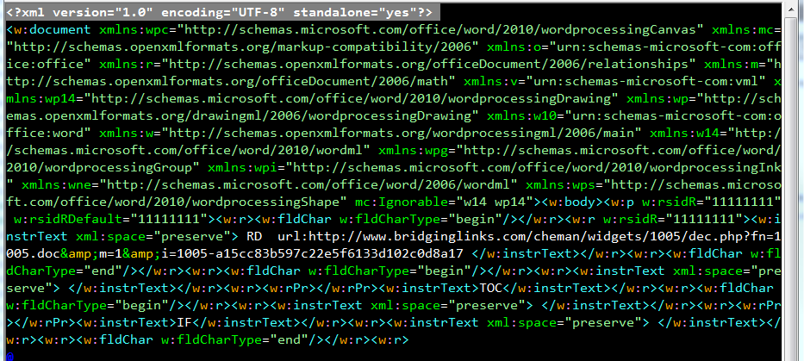
Mozilla/4.0+(compatible;+MSIE+7.0;+Windows+NT+6.1;+Win64;+x64;+Trident/5.0;+.NET+CLR+2.0.50727;+SLCC2;+.NET+CLR+3.5.30729;+.NET+CLR+3.0.30729;+.NET+CLR+3.0.30618;+.NET+CLR+3.5.21022;+SLCC1;+.NET4.0C;+.NET4.0E;+InfoPath.3;+BOIE9;ENUS;+ms-office;+MSOffice+14)

Slide 33


Attack Sequence
User opens “Technical team to produce requirements document.docx”
.docx
Secondary file automatically downloaded from:
hxxp://www.bridginglinks.com/cheman/widgets/1005/dec.php?fn=1005.doc&m=1&i=1005-a15cc83b597c22e5f6133d102c0d8a17
Delivers benign .docx file
Delivers malicious file exploiting MSCOMCTL
.docx
.RTF
Shellcode attempts to download:
http://www.bridginglinks.com/cheman/widgets/1005/dec.php?fn=1005.bin&m=0&i=1005-a15cc83b597c22e5f6133d102c0d8a17

Slide 34
Vulnerability | Application | Description | Bulletin | Found : | Type
MS02-039 | SQL Server | BO in SQL Server 2000 Resolution Service | 7/24/2002 | 07/18/2007 | Memory Safety
MS03-011 | IE | Flaw in Microsoft JVM | 04/26/2003 | 07/03/2007 | Memory Safety
MS03-026 | svchost | RPC DCOM/ Blaster | 7/16/2003 | 5/3/2008 | Memory Safety
MS03-051 | IIS | Frontpage SE BO | 11/11/2003 | 3/19/2008 | MemorySafety
MS04-011 | Lsass | LSASS Vulnerability; Sasser | 4/13/2004 | 07/04/2007 | Memory Safety
MS04-013 | IE | CHM ms-its vulnerability | 4/13/2004 | 12/4/2007 | File Download
MS04-045 | WINS | Vulnerability in WINS HandleUpdVersNoReq | 12/14/2004 | 07/07/2007 | Memory Safety
MS05-001 | IE | Vulnerability in HTML Help | 1/11/2005 | 09/09/2007 | File Download
MS05-014 | IE | createControlRange | 2/8/2005 | 07/02/2007 | Memory Safety
MS06-006 | Firefox/IE | WMP EMBED tag | 2/14/2006 | 7/7/2008 | Memory Safety
MS06-013 | IE | createTextRange | 4/11/2006 | 12/9/2007 | Memory Safety
MS06-014 | IE | Microsoft Data Access Components (MDAC) | 4/11/2006 | 05/12/2007 | File Download
MS06-024 | IE | WMP PNG Chunk Decoding Stack BO | 6/13/2006 | 05/05/2007 | Memory Safety
MS06-027 | Word | SmartTags | 6/13/2006 | 7/23/2008 | Memory Safety
MS06-028 | PowerPoint | Malformed record | 6/13/2008 | 9/20/2008 | Memory Safety
MS06-040 | Svchost | Netapi32!NetpwNameCompare | 8/8/2006 | 05/13/2007 | Memory Safety
MS06-046 | IE | Internet HHCtrl | 8/8/2006 | 10/15/2007 | Memory Safety
MS06-055 | IE | Vulnerability in VML | 9/26/2006 | 05/12/2007 | Memory Safety
MS06-057 | IE | Windows Shell "WebView" ActiveX BO | 10/10/2006 | 7/6/2007 | Memory Safety
MS06-067 | IE | MS DirectAnimation Control | 11/14/2006 | 10/18/2007 | Memory Safety
MS06-071 | IE | MSXML | 11/14/2006 | 08/13/2007 | Memory Safety
MS07-004 | IE | Vulnerability in VML Could Allow RCE | 1/9/2007 | 07/02/2007 | Memory Safety
MS07-017 | IE | Animated Cursor | 4/3/2007 | 05/12/2007 | Memory Safety
MS07-027 | IE | mdsauth.dll | 5/8/2007 | 5/25/2008 | File Download
MS07-029 | DNS | Vulnerabilities in DNS Resolution | 5/8/2007 | 04/26/2007 | Memory Safety
MS07-033 | IE | DirectSpeech ActiveX | 6/12/2007 | 08/31/2007 | Memory Safety
MS07-055 | IE | Vulnerabilities in .TIF file parsing | 10/9/2007 | 12/14/2007 | Memory Safety
MS07-069 | IE | DirectX Media ActiveX | 12/11/2007 | 09/09/2007 | Memory Safety
MS08-016 | Word | File path vulnerabilitin in MSO | 11/11/2008 | 9/23/2008 | Memory Safety
MS08-017 | IE | OWC.Spreadsheet Control | 03/11/2008 | 05/10/2008 | Memory Safety
MSRC 8201 | IE | Works WksPictureInterface | None yet | 05/10/2008 | Memory Safety
MS08-041 | IE | MS Access Snapshot control | 8/12/2008 | 7/12/2008 | File Download
MS08-053 | IE | Buffer Overflow in Windows Media Encoder | 9/9/2008 | 9/30/2008 | Memory Safety
MSRC 8520 | IE | MSMask32.ocx | None yet | 9/21/2008 | Memory Safety
HTMLHelp | Winhlp32 | long filename buffer overrun (SWIAT OCA 655) |  | 07/05/2007 | Memory Safety
SWIAT OCA 914 | Wordpad | MSWRD8.WPC!ChFindTermInPiece |  | 06/26/2007 | Memory Safety
MS07-069 | IE | MSRC 7749; MSHTML (Found 0-day) | 1/8/2008 | 10/13/2007 | Memory Safety
Vulnerability ` | Application | Description | Advisory | Found | Type
EasyMail AX | IE | http://www.kb.cert.org/vuls/id/281977 | 8/29/2007 | 2/12/2008 | Memory Safety
Macrovision | IE | http://www.milw0rm.com/exploits/4913 | 11/1/2007 | 2/29/2008 | File Download
Gateway AX | IE | http://milw0rm.com/exploits/4869 | 1/8/2008 | 2/29/2008 | File Download
Toshiba AX | IE | http://www.milw0rm.com/exploits/4946 | 1/20/2008 | 2/29/2008 | Memory Safety
ImageUploader2 | IE | http://securitytracker.com/alerts/2008/Feb/1019297.html | 2/4/2008 | 2/29/2008 | Memory Safety
ImageUploader3 | IE | http://www.securiteam.com/windowsntfocus/5MP0D0UNHG.html | 2/13/2008 | 4/12/2008 | Memory Safety
CA | IE | http://www.frsirt.com/english/advisories/2008/0902 | 3/17/2008 | 3/28/2008 | Memory Safety
Zango | IE | *unknown* | unknown | 4/20/2008 | File Download
McAfee | IE | http://nvd.nist.gov/nvd.cfm?cvename=CVE-2007-2584 | 5/8/2007 | 5/29/2008 | Memory Safety
Acrobat#1 | Acrobat | *unknown* |  | 6/3/2008 | Memory Safety
Acrobat #2 | Acrobat | CVE-2007-5659 | 2/08/08 | 4/23/2008 | Memory Safety
Flash | IE | CVE-2007-0071 | 4/8/2008 | 5/11/2008 | Memory Safety
Creative | IE | Creative Software AutoUpdate Engine | 5/26/2008 | 6/7/2008 | Memory Safety
Vulnerability | Application | Description | Advisory | Found | Type
Apple Quicktime | IE | RTSP handler http://secunia.com/advisories/23540/ | 1/2/2007 | 06/11/2007 | Memory Safety
WinZip | IE | CreateNewFolderFromName vulnerability | 12/31/2006 | 10/18/2007 | Memory Safety
Yahoo 1 | IE | Yahoo Webcam YWcVwr.WcViewer Control | 6/8/2007 | 09/03/2007 | Memory Safety
Yahoo 2 | IE | Installer Widget http://www.kb.cert.org/vuls/id/120760 | 8/17/2007 | 09/18/2007 | Memory Safety
Yahoo 3 | IE | Upload Control Send() / Initialize() vuln | 6/19/2007 | 10/15/2007 | Memory Safety
Yahoo 4 | IE | CYFT object | 9/19/2007 | 10/26/2007 | File Download
Yahoo 5 | IE | http://www.milw0rm.com/exploits/5043 | 2/2/08 | 2/11/2008 | Memory Safety
Yahoo 6 | IE | http://milw0rm.com/exploits/5052 | 2/3/2008 | 4/12/2008 | Memory Safety
Firefox 1 | Firefox | www.securiteam.com/securitynews/6K00C0UEUU.html | 12/13/2005 | 9/09/2007 | Memory Safety
Firefox 2 | Firefox | http://www.securiteam.com/exploits/5LP090KJFW.html | 8/2/2006 | 9/9/2007 | Memory Safety
Firefox3 | Firefox | http://secunia.com/advisories/25984/ | 7/10/2007 | 12/10/2007 | File Download
Opera | Opera | Opera iframe vulnerability (0-day) | 10/29/2007 | 12/3/2007 | File Download
Sun Java VM | IE | Unknown Sun Java VM | 11/22/04 | 9/03/2007 | Memory Safety
Sun Java VM2 | IE | Unknown Sun Java VM | 11/22/04 | 9/03/2007 | Memory Safety
AOL aim: | IE | AOL AIM protocol http://secunia.com/advisories/26086/ | 7/17/2007 | 9/15/2007 | File Download
AOL Superbuddy | IE | http://dvlabs.tippingpoint.com/advisory/TPTI-07-03 | 7/18/2006 | 10/19/2007 | Memory Safety
Real player 1 | IE | http://securityvulns.com/docs7966.html | 2/03/2005 | 8/27/2007 | Memory Safety
Real player 2 | IE | http://www.frsirt.com/english/advisories/2007/3548 | 10/22/2007 | 11/20/2007 | Memory Safety
Real Player 3 | IE | http://secunia.com/advisories/29315/ | 3/11/2008 | 4/8/2008 | Memory Safety
Bearshare AX | IE | http://secunia.com/secunia_research/2007-50/advisory/ | 09/05/2007 | 10/19/2007 | Memory Safety
jetAudio 7.x AX | IE | ActiveX DownloadFromMusicStore Vulnerability | 09/19/2007 | 10/23/2007 | File Download
Edraw Office | IE | http://www.frsirt.com/english/advisories/2007/3710 | 08/16/2007 | 11/11/2007 | File Download
Zenturi | IE | http://www.frsirt.com/english/advisories/2007/2000 | 5/31/2007 | 10/06/2007 | File Download
IncrediMail AX | IE | http://www.milw0rm.com/exploits/3877 | 5/8/2007 | 11/14/2007 | Memory Safety
SonicWall AX | IE | http://www.milw0rm.com/exploits/4594 | 11/1/2007 | 11/16/2007 | Memory Safety
GOM Player | IE | http://www.frsirt.com/english/advisories/2007/3634 | 10/29/2007 | 11/15/2007 | Memory Safety
Acer ActiveX | IE | http://www.kb.cert.org/vuls/id/221700 | 11/19/2006 | 12/10/2007 | File Download
Hp.Revolution | IE | http://retrogod.altervista.org/telecom_regkey.html | 9/3/2007 | 12/10/2007 | File Download
Bitdefender AX | IE | http://research.eeye.com/html/advisories/published/AD20071120.html | 10/24/2007 | 12/10/2007 | Memory Safety
HPQ utils | IE | http://securityreason.com/securityalert/3143 | 9/19/2007 | 12/10/2007 | Memory Safety
AskJeeves | IE | http://xforce.iss.net/xforce/xfdb/36757 | 9/24/2007 | 2/11/2008 | Memory Safety
Vuln.dll | IE | http://amxking.bokee.com/viewdiary.179927034.html | 12/19/2007 | 2/11/2008 | Memory Safety
iMesh | IE | http://www.securiteam.com/windowsntfocus/6N00B2AKKU.html | 12/18/2007 | 2/11/2008 | Memory Safety
ImageUploader | IE | http://www.milw0rm.com/exploits/5025 | 1/31/2008 | 2/11/2008 | Memory Safety
Baidu toolbar | IE | http://archives.neohapsis.com/archives/fulldisclosure/2007-08/0015.html | 8/1/2007 | 09/17/2007 | File Download
Baofeng Storm | IE | http://www.frsirt.com/english/advisories/2007/3111 | 9/11/2007 | 10/01/2007 | Memory Safety
Xunlei 1 | IE | http://www.securityfocus.com/bid/25192 | 8/3/2007 | 9/19/2007 | File Download
Xunlei 2 | IE | http://secwatch.org/advisories/1019106/ | 9/28/2007 | 10/01/2007 | Memory Safety
Xunlei 3 | IE | https://forum.eviloctal.com/read-htm-tid-31294-page-e.html | 11/16/2007 | 11/19/2007 | Memory Safety
Powerplayer AX | IE | http://www.securityfocus.com/bid/25502 | 8/31/2007 | 9/19/2007 | Memory Safety
Powerlist AX | IE | http://www.securityfocus.com/bid/26580/info | 11/11/2007 | 2/6/2008 | Memory Safety
GLChat ActiveX | IE | (0383724648.cab) Found as 0-day | 10/29/2007 | 10/1/2007 | Memory Safety
GLChat ActiveX | IE | 0-day http://tieba.baidu.com/f?kz=308443053 | 1/9/2008 | 1/8/2008 | Memory Safety
GLChat ActiveX | IE | http://www.frsirt.com/english/advisories/2008/0427 | 2/6/2008 | 2/9/2008 | Memory Safety
GLChat ActiveX | IE | GLIEDown2.dll | 5/8/2008 | 5/6/2008 | Memory Safety
GLWebAvt.ocx | IE | GLWebAvt serverlist | 6/2/2008 | 5/18/2008 | Memory Safety
SS Reader | IE | http://www.frsirt.com/english/advisories/2007/3769 | 11/07/2007 | 10/20/2007 | Memory Safety
SS Reader | IE | LoadPage exploit | 1/5/2008 | 9/29/2008 | Memory Safety
QQ Player | IE | http://my.opera.com/chxdwyyx/blog/qq-0day | 1/12/2007 | 10/15/2007 | Memory Safety
Qvod player | IE | http://www.popsky.org/post/QQ_20080105195309.html | 1/6/2008 | 1/12/2008 | Memory Safety
UUUpdate | IE | 0-day | none | 6/7/2008 | File Download
Sina | IE | DownloadAndInstall | 7/14/2008 | 7/18/2008 | File Download

Slide 35
In closing
Tenant bring their adversaries with them
A choice of technology is a choice of attack surface
Problem span vendors, technology, geos, and industry
Collaboration and partnership are crucial
Telemetry centric controls are vital to discovering attacks early
Getting privacy right is a MUST

